Slide 1
Lecture 4
Crop science
Yield components

Slide 2
Yield
Crop yield is determined by plant growth and partitioning of biomass to marketable parts of plants
Growth and partitioning are affected by developmental stages of crops
Knowledge of physiological processes of growth, development, and partitioning into yield components is necessary for a basic understanding of maximizing crop yield
Yield parameters include leaf area, shoot, root, and total weights, or plant height

Slide 3
Yield components
Yield components can be divided into plant developmental stages of growth
Yield components are important in many crop research programs
Plant breeders improve yield by selecting components of yield such as seeds per plant or thousand grain weight
Components for grain yield of cereal crops, numbers of branches appear to be important in developing high-yielding cultivars
Grain yield in field crops is determined by components like ear per unit area, or ear weights
legumes are determined by numbers of pods per unit area, grains per pod, and dry weights of grain

Slide 4
Yield calculation
Yield = grain weight X number of grains per area
Eg yield of the maize plant with 100 grains per cob weighing 2 grams
100 grains X 2 grams = 200g X 11,111 = 2,222kg lima
200g X 44,444 plants = 88,888kg hectare

Slide 5
Dry matter production
Dry matter refers to the entire organic dry matter that is produced from essential activities of photosynthesis and protein metabolism
Organic dry matter includes glucose, starch, cellulose, amino acids, protein, and other organic components
Dry matter of plants refers to total biological yield which includes leaves, stalks, straw, roots, and other plant parts as well as economically useful parts such as grains, tubers, and fruit
For agricultural purposes, dry matter yields of many crops refer to aboveground (soil) grown plant parts but may contain belowground plant parts for some crops such as potatoes, cassava

Slide 6
Whole-plant aboveground biomass is the economically useful part of forage plants
Grain is the main useful part of cereals and legumes
Crop production can be measured as total biomass or economically useful plant parts
Total yield of plant material is known as biological yield
Harvest index is ratio of grain yield to biological yield
Eg 200g:1000g = 2:5 or 40%
Differences in translocation of photosynthate to grain may account for differences in harvest indexes

Slide 7
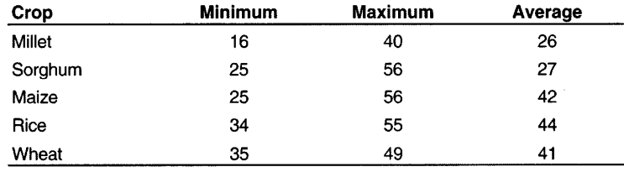
Harvest index
Efficiency of grain production in crop plants has also been frequently related to harvest index
Harvest index reflects partitioning of photosynthate between grain and vegetative plant parts
harvest index for a semidwarf wheat was 47 percent, compared to 40 percent for standard

Slide 8
Factors affecting productivity
Environment, management, and genotypes interact to determine overall yields of crops
Environmental factors, adequate moisture supply and optimum temperature and solar radiation are important in determining yield

